Slide 1
Project meeting (2016-12-12) - DVA313
Created by: Group 2 – Solar energy calculator

Slide 2
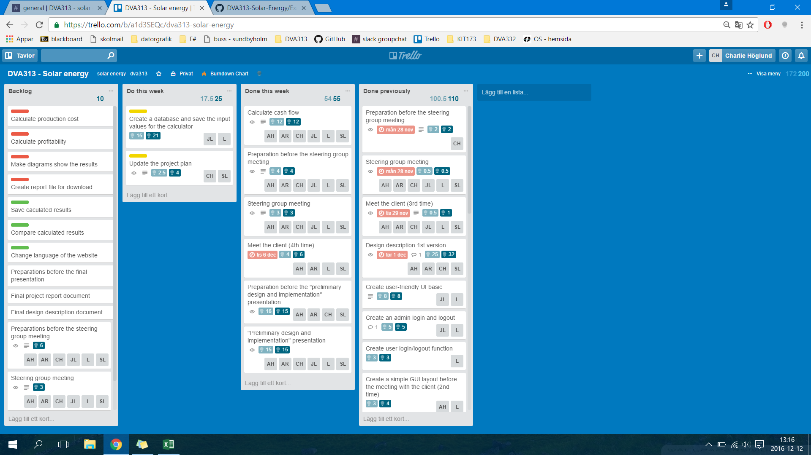
Trello board – Week 49 (previous)

Slide 3
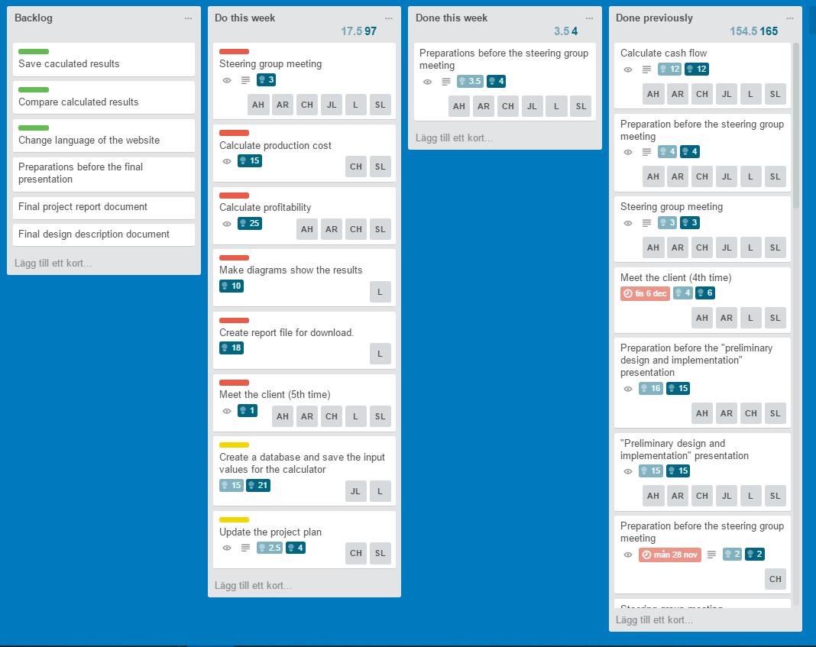
Trello board – Week 50 (present)

Slide 4
Any obstacles, risks or issues that have been identified
Holidays are coming up = possible disturbances in the work flow, communication and integrating each others’ code
Quite a lot of implementation/documentation left to be done – solution: divide the work and start coding/writing
Come up with a good name for the web-tool (Swe/Eng)

Slide 5
Worked hours for each member
Name | Week 1 (hours) | Week 2 (hours) | Week 3 (hours) | Week 4 (hours) | Week 5 (hours) | Total
Lukas Hamacek | 6 | 18 | 10 | 15 | 18 | 63
Aliya Hussain | 7 | 16 | 9 | 10 | 15 | 56
Charlie Höglund | 8 | 19.5 | 14 | 18 | 18,5 | 78
Jonathan Larsson | 6 | 13 | 19.5 | 11 | 16 | 64.5
Sebastian Lindgren | 12.5 | 16.5 | 13 | 12 | 20 | 74
Avalika Reddy | 6 | 13 | 9 | 10 | 15 | 52

Slide 6
Questions for the steering group
…
Next week’s steering group meeting = not mandatory?
If we have any further questions we will email you

